Slide 1
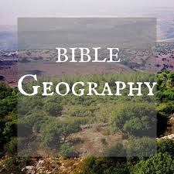
Paul’s Journeys

Slide 2
Map of 1st and 2nd Journey

Slide 3
Aegean Sea – Many small islands

Slide 4
Aegean Sea – Many small islands

Slide 5
Athens, Greece – Acropolis

Slide 6
Athens, Greece – Acropolis

Slide 7
Athens, Greece – Parthenon

Slide 8
Acropolis

Slide 9
Athens, Greece – Nike (Temple of Wingless Victory)

Slide 10
Athens Theater

Slide 11
Temple – Corinth

Slide 12
Corinth, Greece

Slide 13
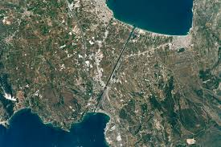
Corinthian Canal

Slide 14
Corinth – Temple of Apollo

Slide 15
Corinthian Port

Slide 16
Cos, Rhodes, Patra
(Acts 21:1) Now it came to pass, that when we had departed from them and set sail, running a straight course we came to Cos, the following day to Rhodes, and from there to Patara.

Slide 17
Rhodes

Slide 18
Rhodes

Slide 19
Rhodes - Stadium

Slide 20
Rhodes - Harbor

Slide 21
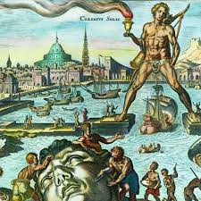
Rhodes – Colossus Harbor Entrance

Slide 22
Patmos – Prison Island

Slide 23
Patmos

Slide 24
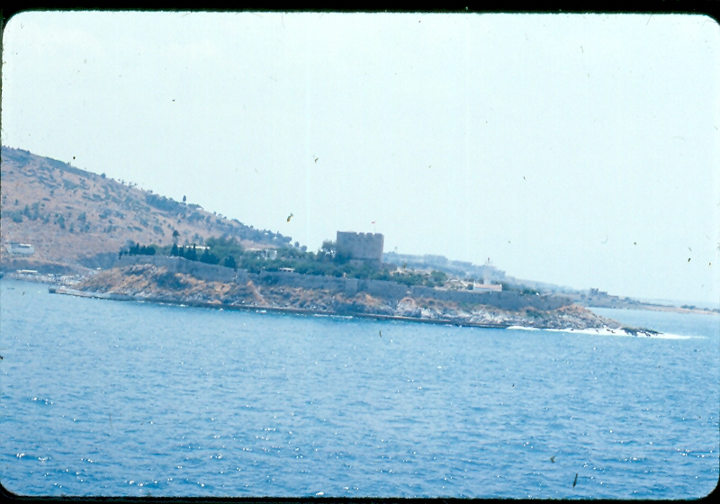
Patmos

Slide 25
Patmos

Slide 26
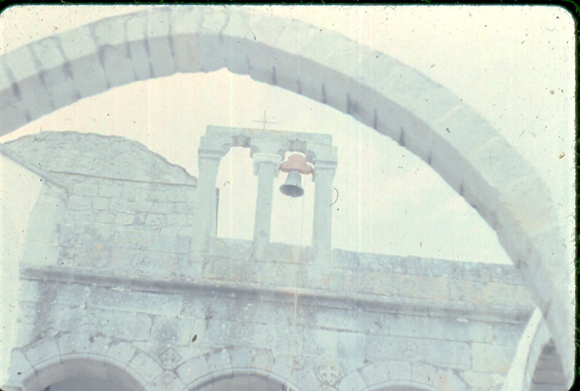
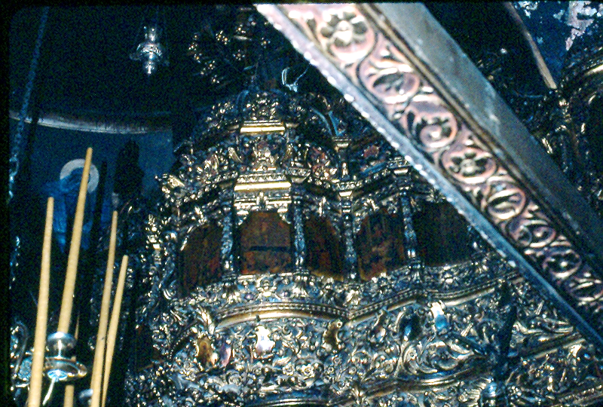
Patmos – St. John’s Church

Slide 27
Asia Minor Eastern Turkey 7 Churches in Revelation

Slide 28
3rd Journey / Journey to Rome

Slide 29
Shipwreck on Malta
(Acts 28:1) Now when they had escaped, they then found out that the island was called Malta.

