Slide 1
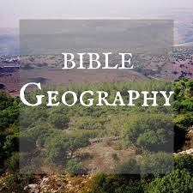
Abraham, Isaac, Jacob

Slide 2
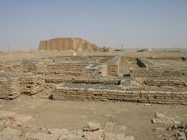
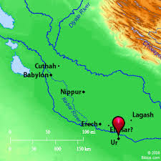
Ur

Slide 3
Genesis 11:31; 12:1-4
(31) And Terah took his son Abram and his grandson Lot, the son of Haran, and his daughter-in-law Sarai, his son Abram's wife, and they went out with them from Ur of the Chaldeans to go to the land of Canaan; and they came to Haran and dwelt there.
(12:1) Now the LORD had said to Abram: "Get out of your country, From your family And from your father's house, To a land that I will show you. (2) I will make you a great nation; I will bless you And make your name great; And you shall be a blessing. (3) I will bless those who bless you, And I will curse him who curses you; And in you all the families of the earth shall be blessed.“ (4) So Abram departed as the LORD had spoken to him, and Lot went with him. And Abram was seventy-five years old when he departed from Haran.

Slide 4
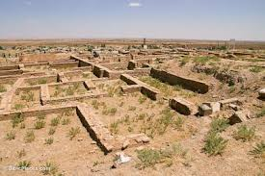
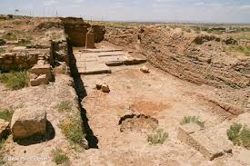
Haran

Slide 5
Genesis 12:8-10
(8) And he moved from there to the mountain east of Bethel, and he pitched his tent with Bethel on the west and Ai on the east; there he built an altar to the LORD and called on the name of the LORD.
(9) So Abram journeyed, going on still toward the South.
(10) Now there was a famine in the land, and Abram went down to Egypt to dwell there, for the famine was severe in the land.

Slide 6
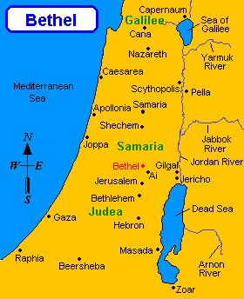

Slide 7
Abraham in Canaan

Slide 8
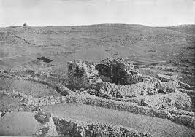
Bethel

Slide 9
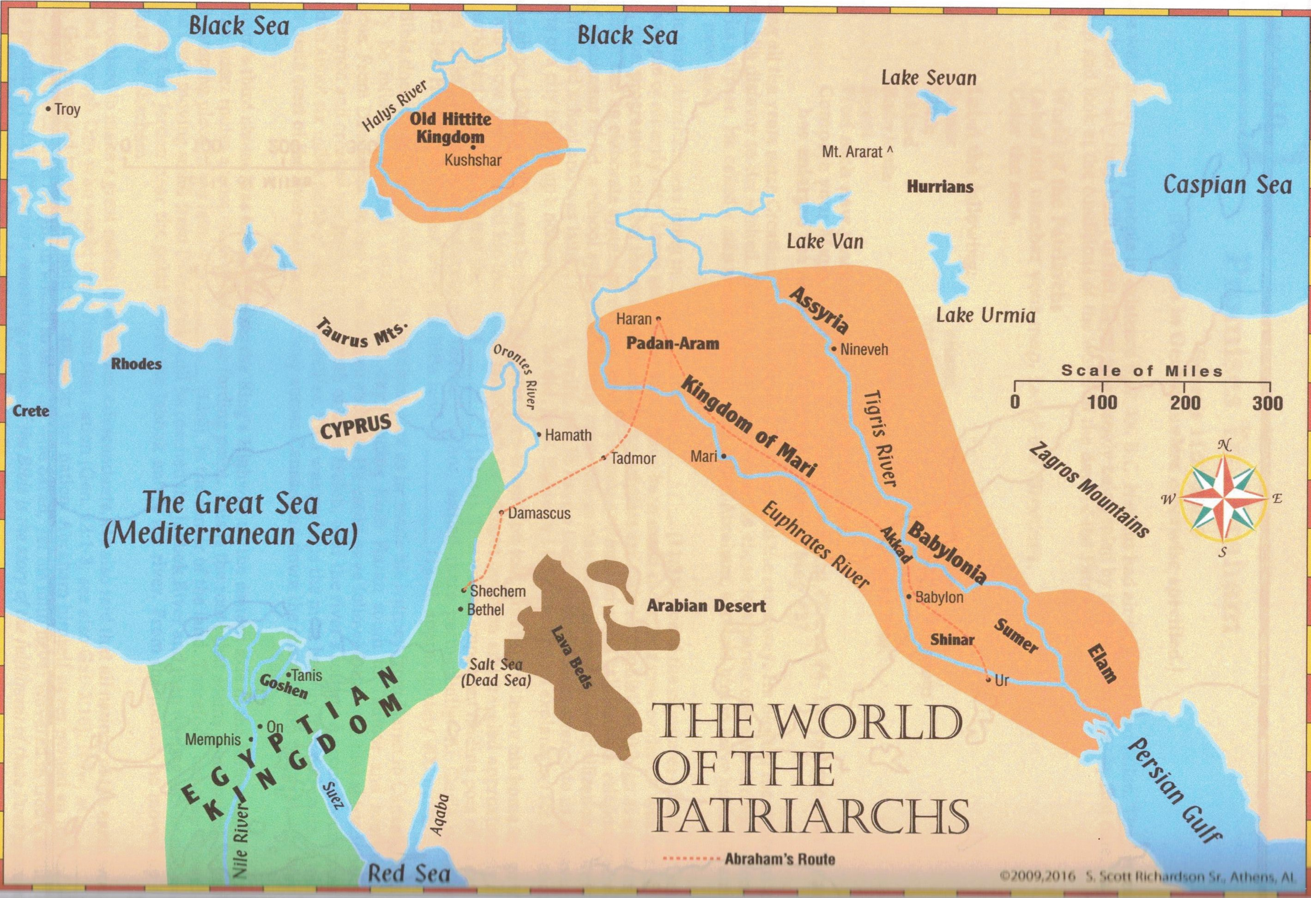

Slide 10
13:10-14
(10) And Lot lifted his eyes and saw all the plain of Jordan, that it was well watered everywhere (before the LORD destroyed Sodom and Gomorrah) like the garden of the LORD, like the land of Egypt as you go toward Zoar. (11) Then Lot chose for himself all the plain of Jordan, and Lot journeyed east. And they separated from each other. (12) Abram dwelt in the land of Canaan, and Lot dwelt in the cities of the plain and pitched his tent even as far as Sodom. (13) But the men of Sodom were exceedingly wicked and sinful against the LORD.

Slide 11
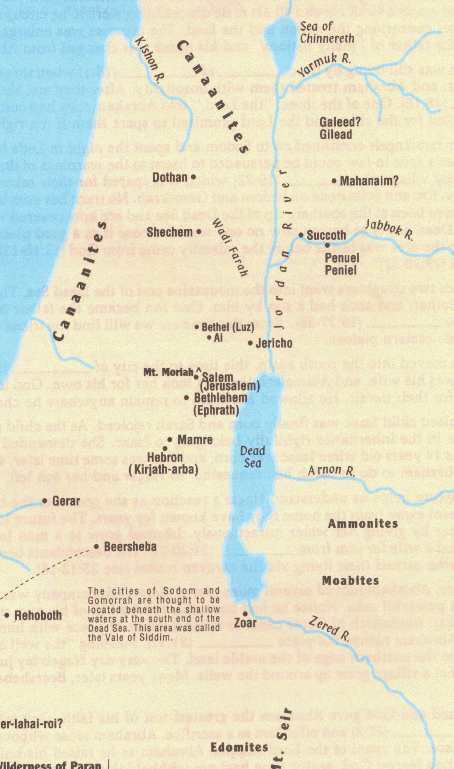
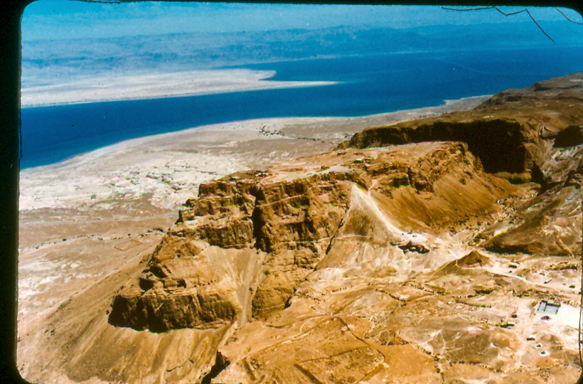
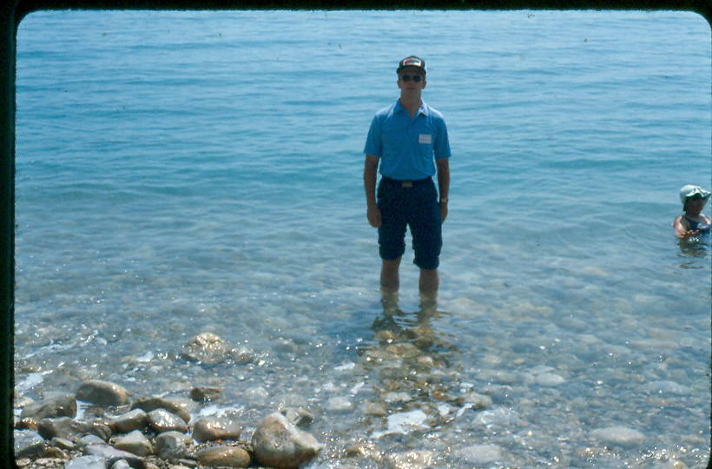

Slide 12
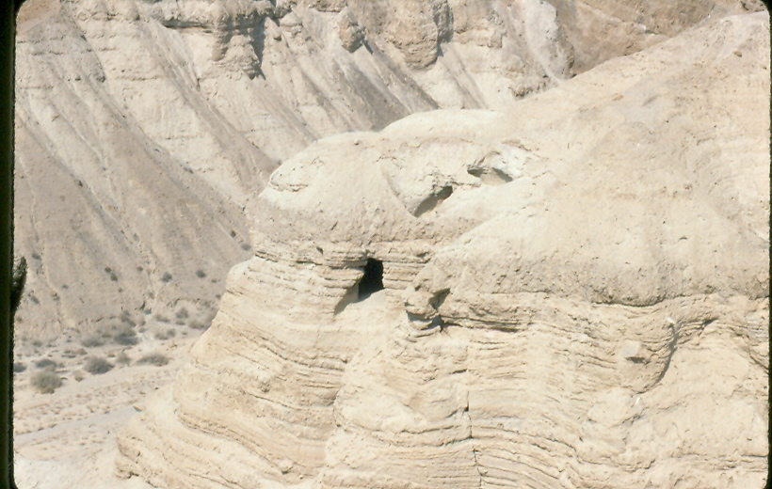
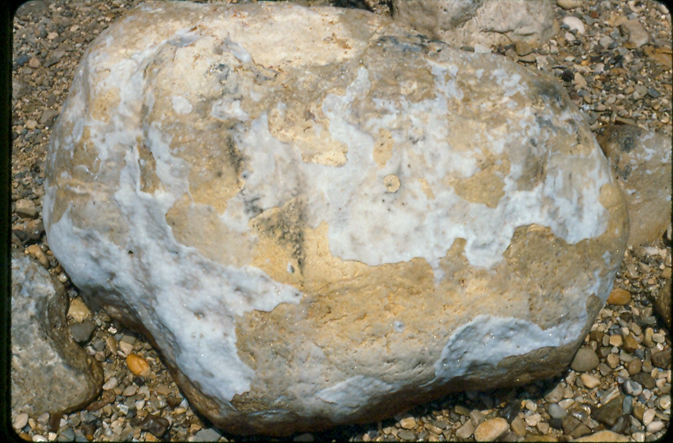

Slide 13
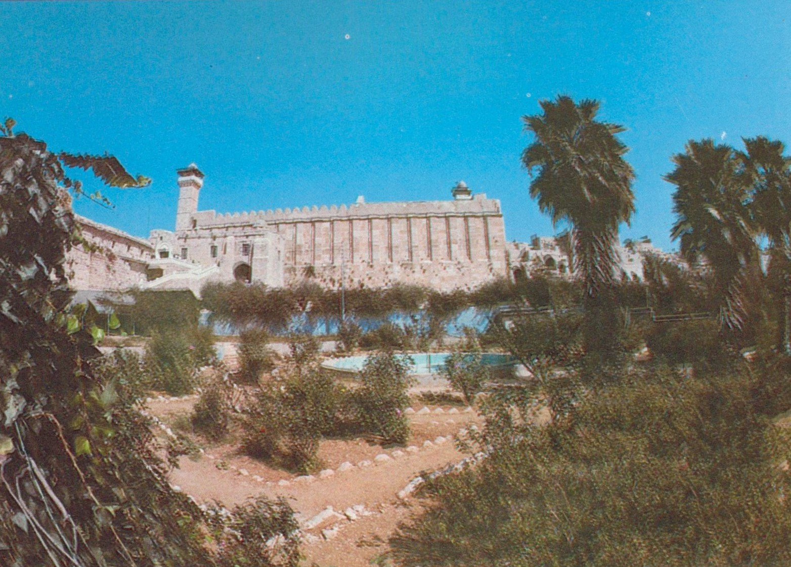
Hebron (Genesis 13:18) Then Abram moved his tent, and went and dwelt by the terebinth trees of Mamre, which are in Hebron, and built an altar there to the LORD.

Slide 14
Abraham’s Family

