Slide 1
The Kingdom
Of Israel

Slide 2
Saul’s Kingdom
Rejected Samuel’s sons to judge them
Wanted a king like other nations
(1 Samuel 8:4-6) Then all the elders of Israel gathered together and came to Samuel at Ramah, (5) and said to him, "Look, you are old, and your sons do not walk in your ways. Now make us a king to judge us like all the nations.“ (6) But the thing displeased Samuel when they said, "Give us a king to judge us." So Samuel prayed to the LORD.

Slide 3
Saul’s Kingdom
Saul is anointed as King
(1 Samuel 10:1) Then Samuel took a flask of oil and poured it on his head, and kissed him and said: "Is it not because the LORD has anointed you commander over His inheritance?
Disobeyed God – 1 Samuel 15
Reigned for 40 years

Slide 4
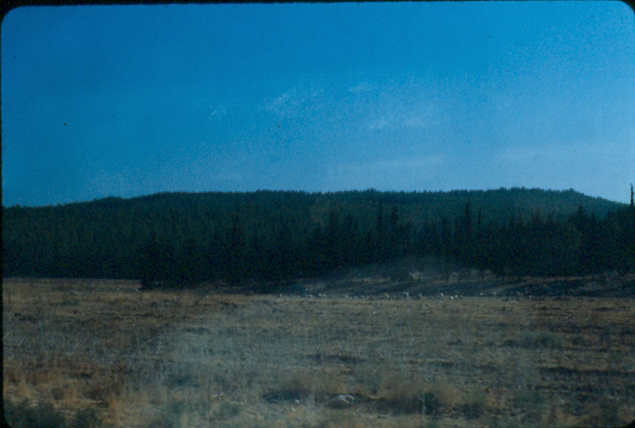
David’s Kingdom
(1 Samuel 17:2) And Saul and the men of Israel were gathered together, and they encamped in the Valley of Elah, and drew up in battle array against the Philistines. (3) The Philistines stood on a mountain on one side, and Israel stood on a mountain on the other side, with a valley between them.
David killed Goliath in the valley of Elah

Slide 5
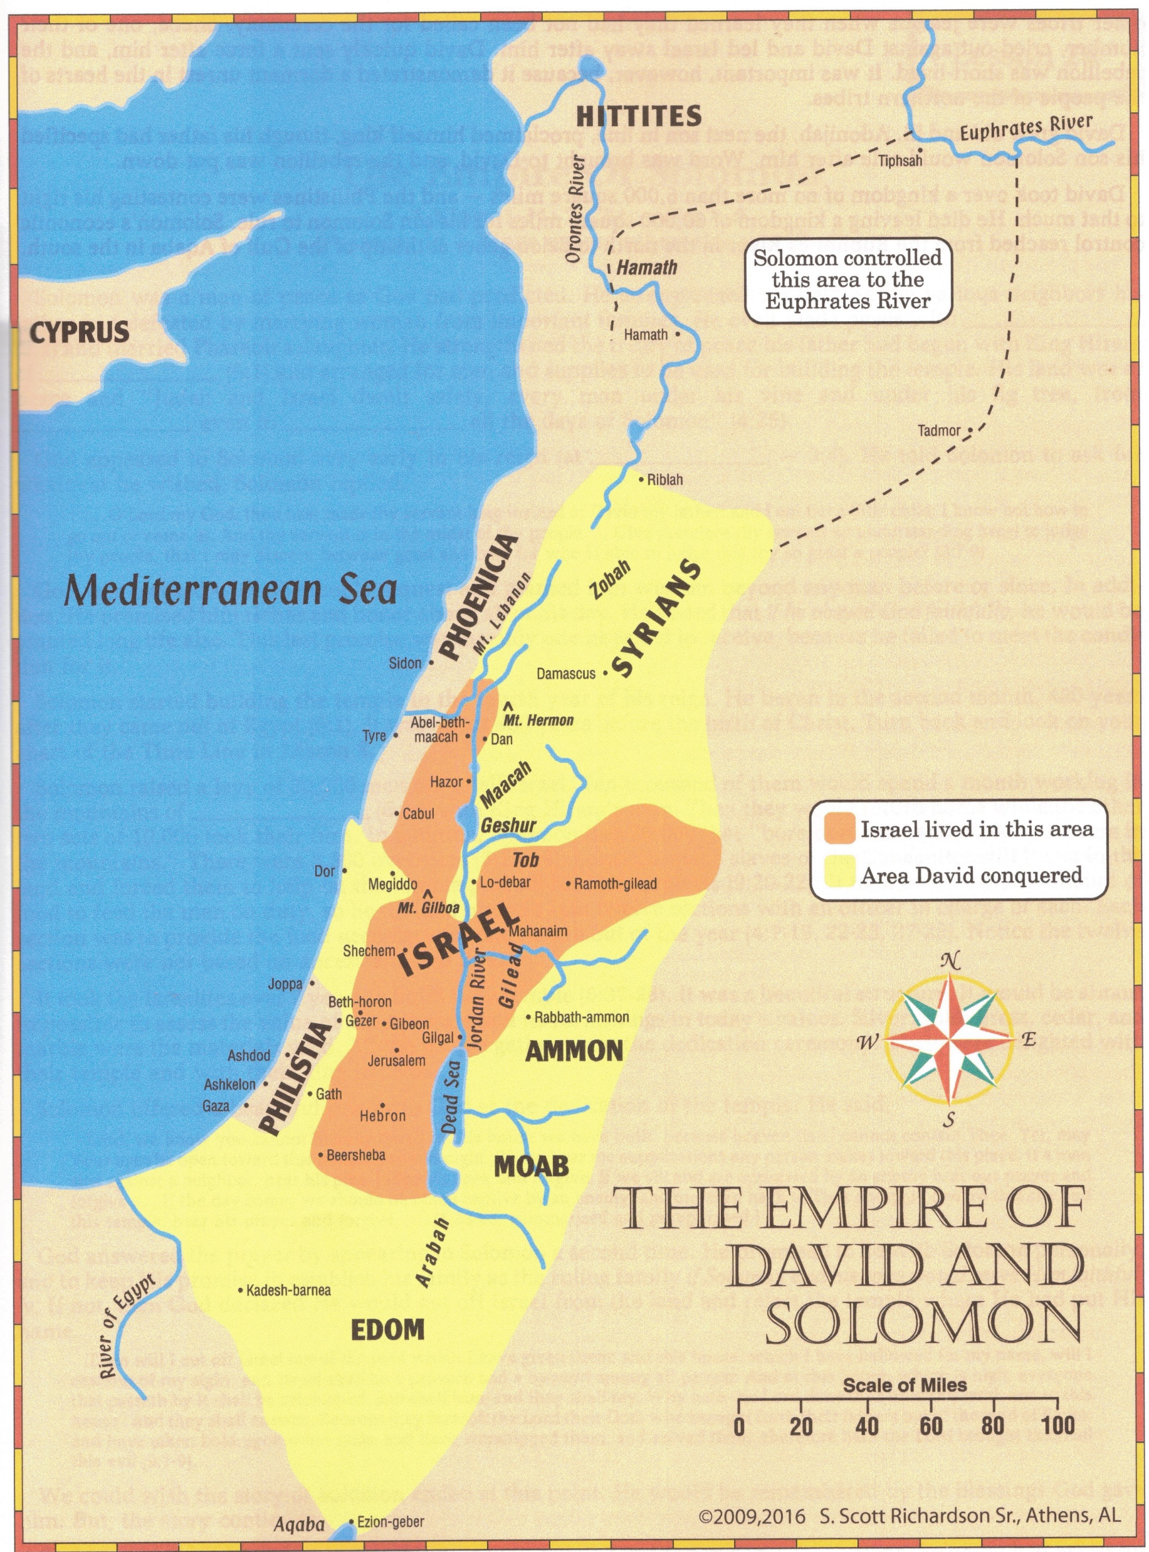
David’s Kingdom
David killed Goliath
Friendship with Johnathan
Hated by Saul, who sought to kill him
David was anointed as the King
(2 Samuel 2:4) Then the men of Judah came, and there they anointed David king over the house of Judah. And they told David, saying, "The men of Jabesh Gilead were the ones who buried Saul.“
David was a king of war, expanded the kingdom by winning battles
David reigned 40 years

Slide 6
Solomon’s Kingdom
(1 Kings 1:39) Then Zadok the priest took a horn of oil from the tabernacle and anointed Solomon. And they blew the horn, and all the people said, "Long live King Solomon!"
Expanded the kingdom by treaty
(1 Kings 11:42-43) And the period that Solomon reigned in Jerusalem over all Israel was forty years. (43) Then Solomon rested with his fathers, and was buried in the City of David his father. And Rehoboam his son reigned in his place.
Solomon reigned 40 years

Slide 7
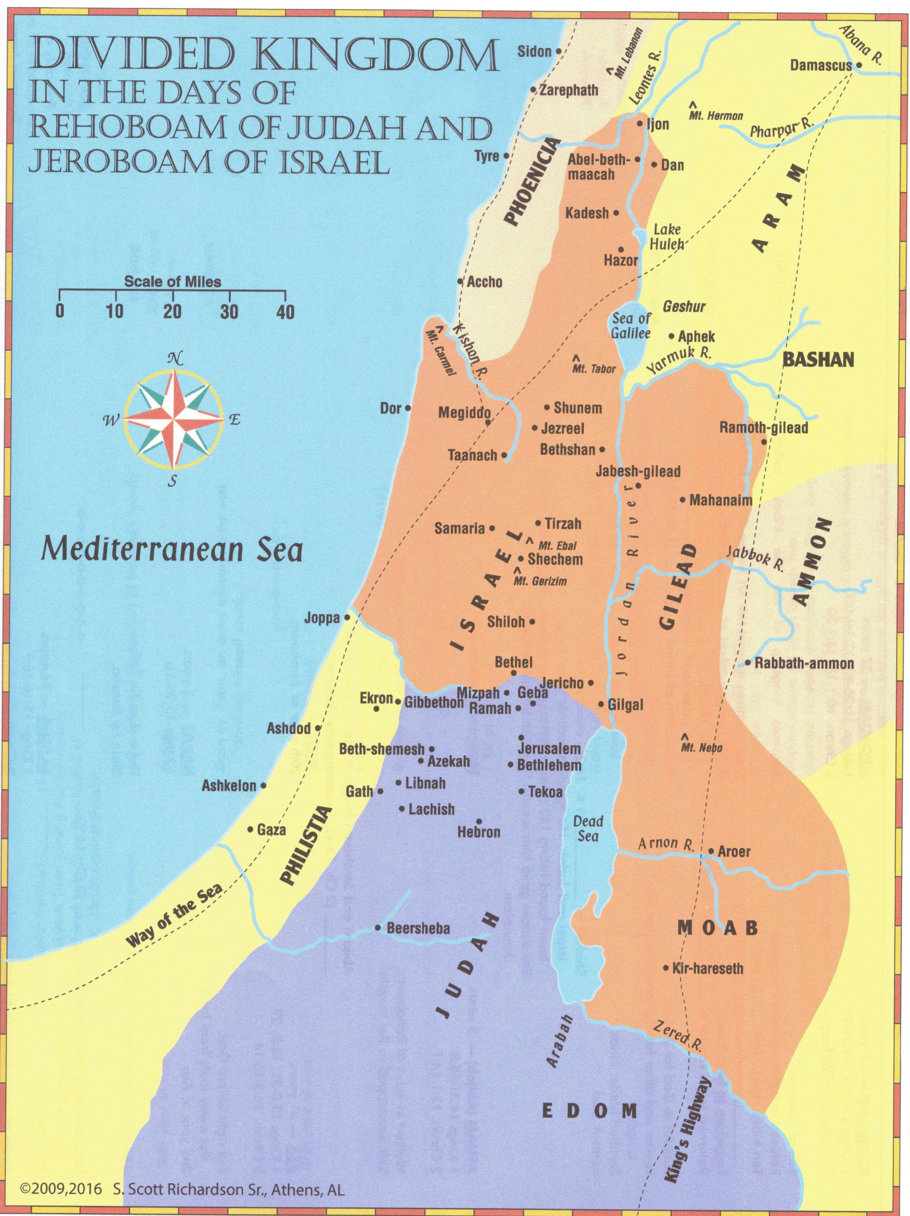
Kingdom Divides – 925 BC
(1 Kings 12:16-17) Now when all Israel saw that the king did not listen to them, the people answered the king, saying: "What share have we in David? We have no inheritance in the son of Jesse. To your tents, O Israel! Now, see to your own house, O David!" So Israel departed to their tents. (17) But Rehoboam reigned over the children of Israel who dwelt in the cities of Judah.
Jeroboam – king of ISRAEL (10 tribes)
Capital at Samaria
Rehoboam – king of JUDAH (2 tribes)
Capital at Jerusalem

Slide 8
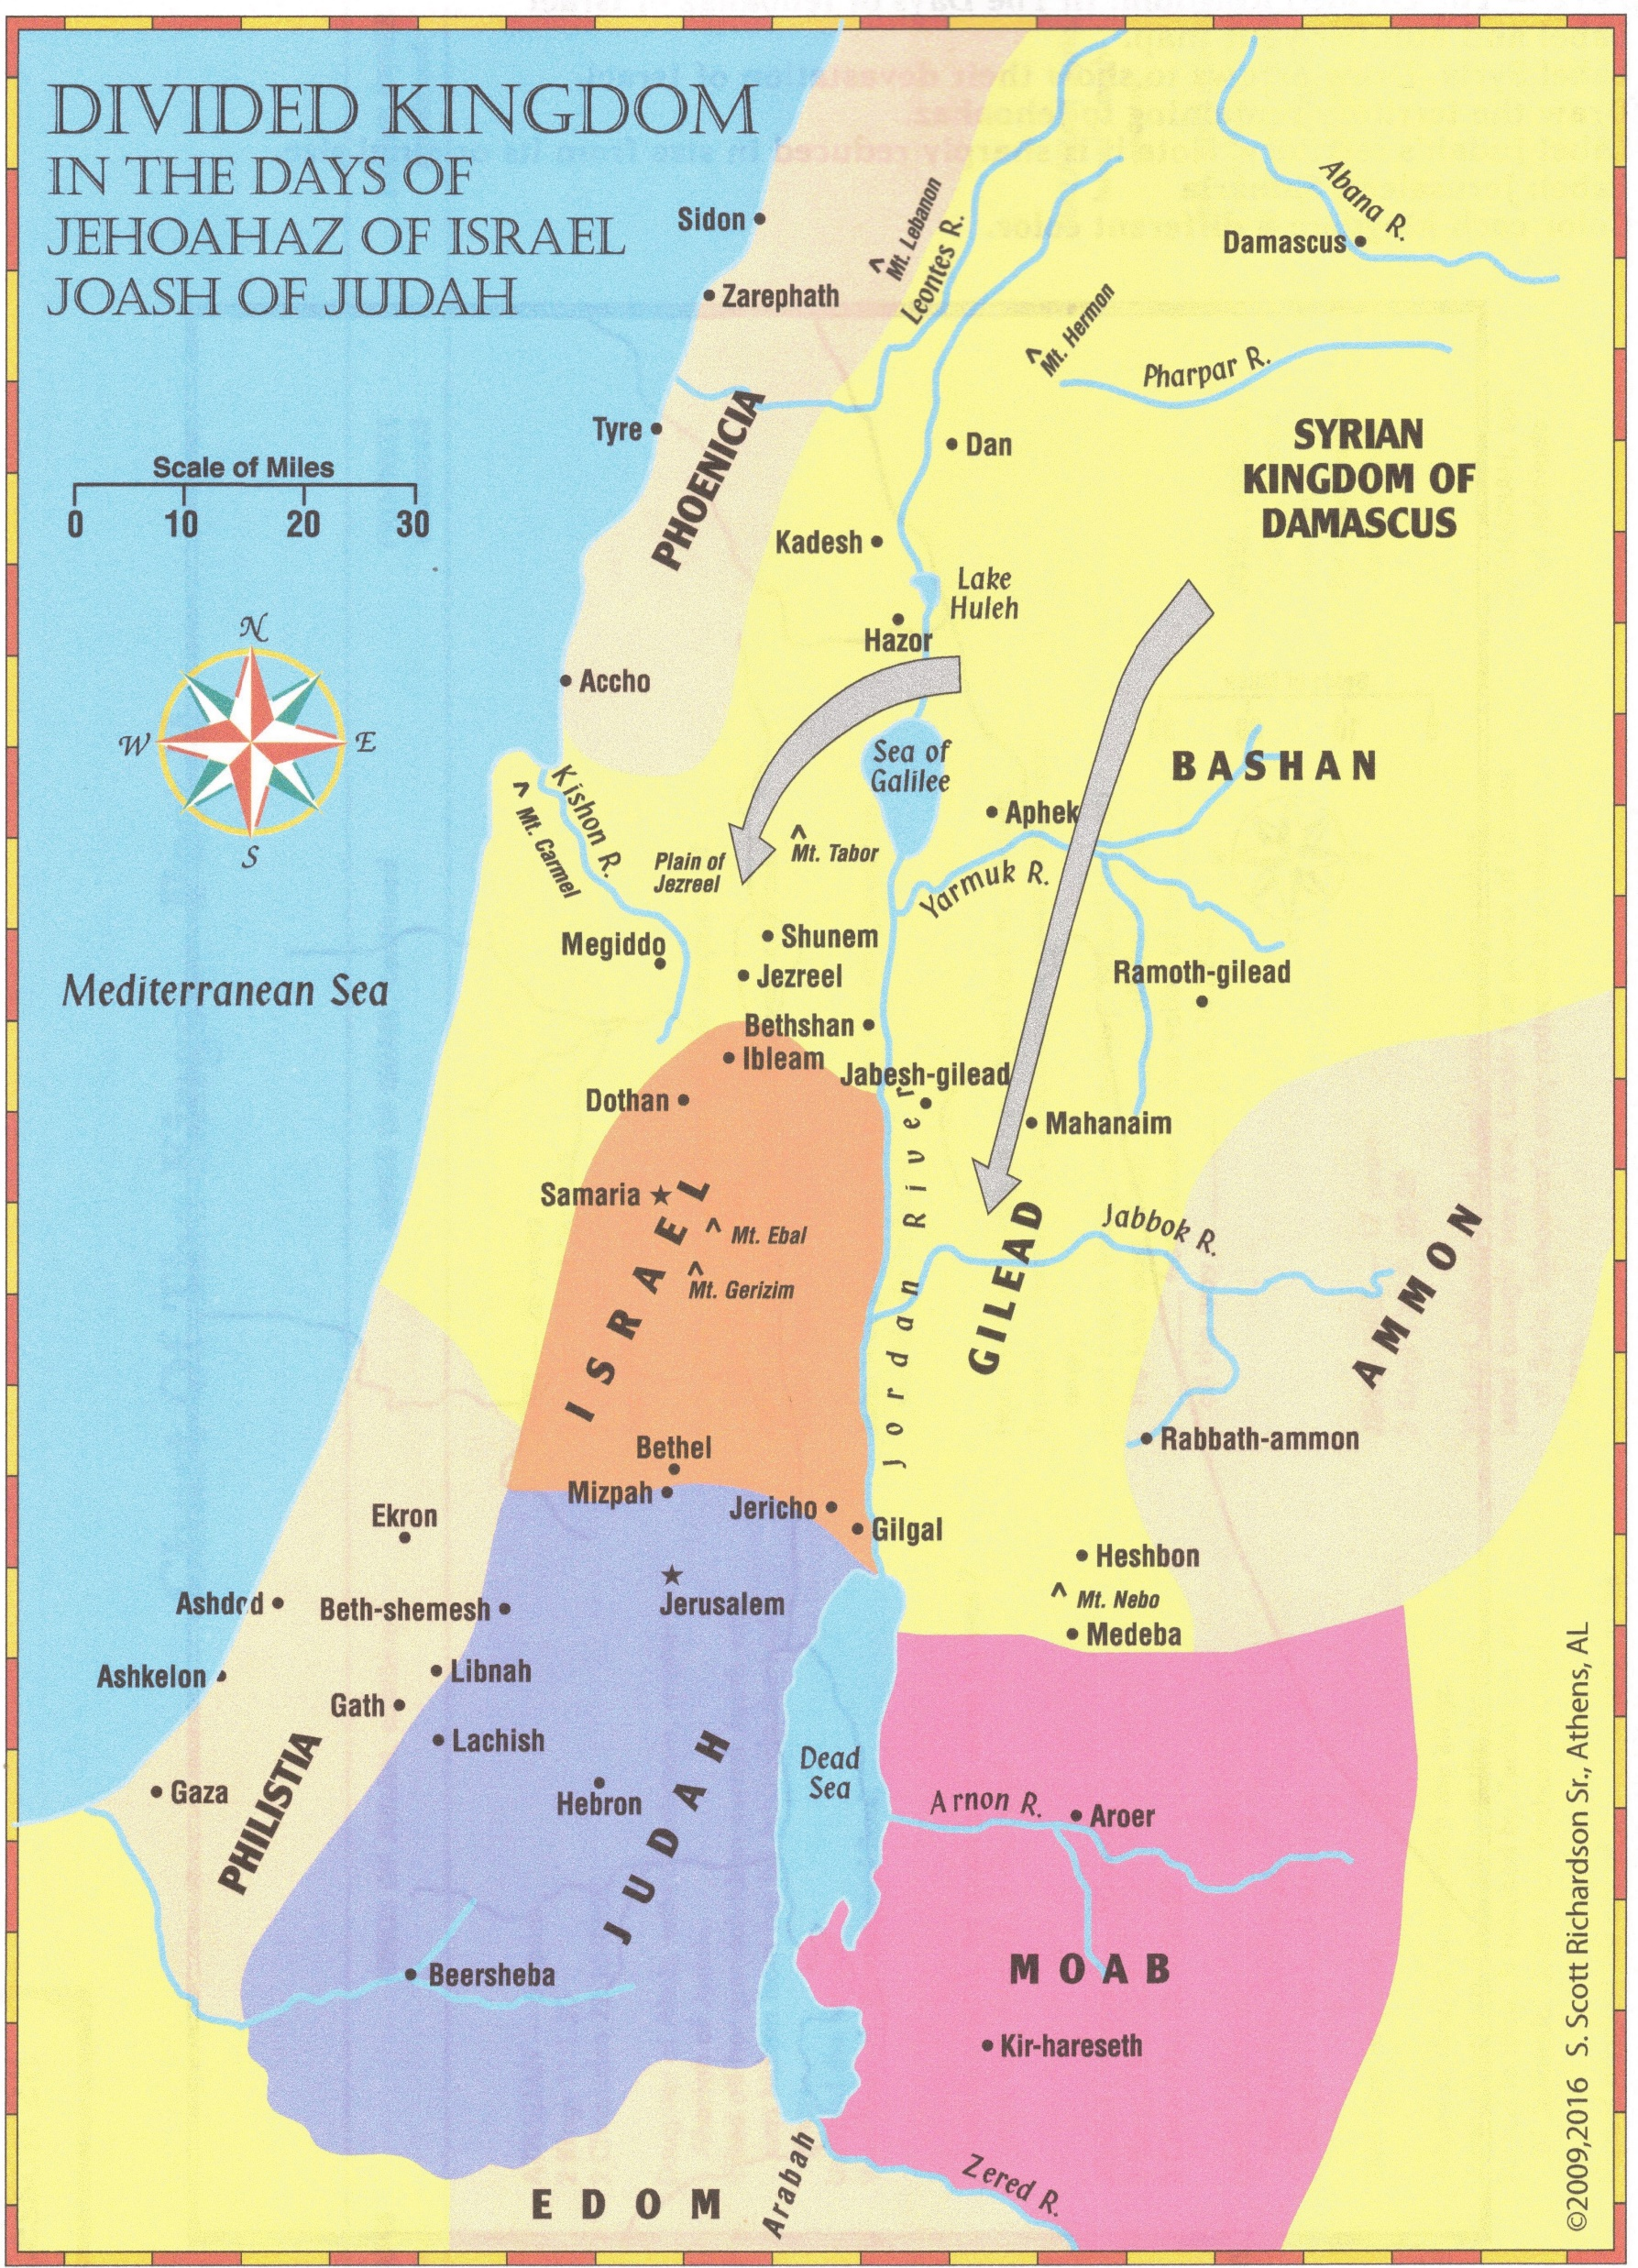
Kingdom Divided
100 years later – 825 BC
Jehoahaz – king of Israel (northern kingdom)
Joash – king of Judah (southern kingdom)

Slide 9
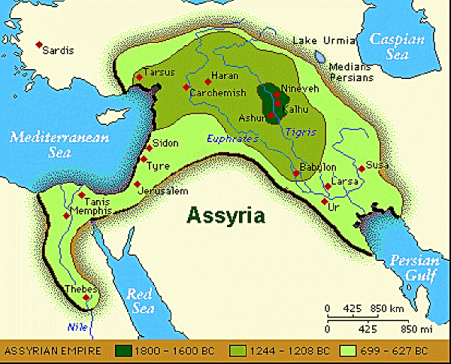
Israel taken to Assyria – 722 BC
Assyria always had Nineveh as its capital
Remember Jonah and the book of Nahum
Most inter-married, did not return, did not follow the Law of Moses
Just a few (a remnant) came back and joined Judah

Slide 10
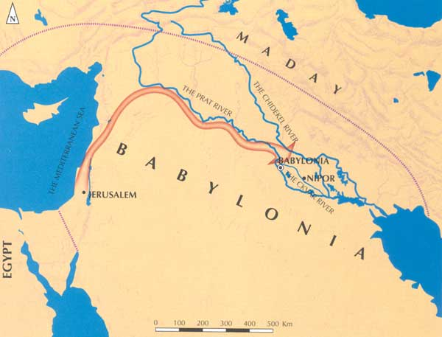
Judah taken to Babylon – 3 stages
606 – King and all in government, and power
597 – Useful workers, anyone with a skill – included – Daniel and Ezekiel
586 – Sieged Jerusalem 2 years, total destruction of city and temple

Slide 11
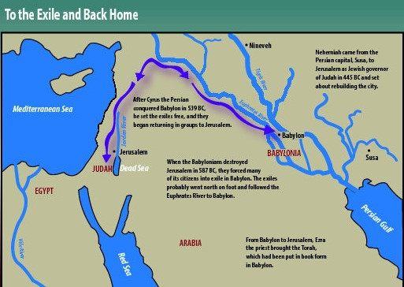
Judah returns to Jerusalem – 2 stages
458 – Ezra establishes the Law of Moses
445 – Nehemiah returns to rebuild the walls and restore the city
Zerubbabel – re-established the priesthood and worship

