Slide 1
A Vision of Yourself
Do you have a vision of what you will
be like 1 year from now?

Slide 2
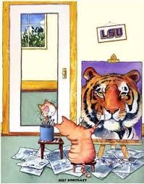
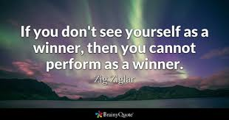
How do you see yourself?

Slide 3
Theme for this year: 20/20 Vision
What is your personal view for yourself?
Some might call this new year resolutions.
Do you see the need to improve, change, start doing something, stop doing something?
What is your spiritual vision?

Slide 4
1 – Vision to have more of God’s Word
Read the Bible every day is a good start.
Study the Bible every day is better.
Read – Study – Meditate – Keep it in your heart – best.

Slide 5
1 – Vision to have more of God’s Word
Your word I have hidden in my heart, That I might not sin against You. (Psalms 119:11)

Slide 6
2 – Vision to obey God’s Word
Is Jesus your LORD?
If you love Jesus – keep His commandments. (John 14:15)
Not enough to read the Bible. We must obey the Bible.

Slide 7
3 – Vision to master self-denial
Then Jesus said to His disciples, "If anyone desires to come after Me, let him deny himself, and take up his cross, and follow Me. (Matthew 16:24)

Slide 8
3 – Vision to master self-denial
This is hard to do.
If we want to follow Christ, we must lower ourselves and He must be first in our life.
Self-denial means to deny anything that hinders us from following Christ.

Slide 9
4 – Vision to say “No.”
For the grace of God that brings salvation has appeared to all men, 12 teaching us that, denying ungodliness and worldly lusts, we should live soberly, righteously, and godly in the present age, 13 looking for the blessed hope and glorious appearing of our great God and Savior Jesus Christ, (Titus 2:11-13)

Slide 10
4 – Vision to say “No.”
The word “no” is powerful.
We must say “no” to some things.
We must grow in ability to discern right and wrong
We must say “no” to requests that take us away from God.

Slide 11
5 – Vision to love others.
Jesus said to him, 'YOU SHALL LOVE THE LORD YOUR GOD WITH ALL YOUR HEART, WITH ALL YOUR SOUL, AND WITH ALL YOUR MIND.’ 38 This is the first and great commandment. 39 And the second is like it: 'YOU SHALL LOVE YOUR NEIGHBOR AS YOURSELF.’ 40 On these two commandments hang all the Law and the Prophets." (Matthew 22:37-40)

Slide 12
5 – Vision to love others.
One of the great commandments is to love your neighbor as you love yourself.
How you see yourself determines how you love others.
We must learn to love others.
It starts with how you love yourself and your life.

Slide 13
Conclusion
Have a vision for your life.
Make these views – your life from this day forward.
Where are you headed in this year?

