Slide 1
The Church as FAMILY

Slide 2
Ephesians 5:25-27
(Ephesians 5:25) Husbands, love your wives, just as Christ also loved the church and gave Himself for her,
(Ephesians 5:26) that He might sanctify and cleanse her with the washing of water by the word,
(Ephesians 5:27) that He might present her to Himself a glorious church, not having spot or wrinkle or any such thing, but that she should be holy and without blemish.

Slide 3
The Church Family
The church is the family of God.
We are brothers and sisters in Christ.
God expects us to act like FAMILY.

Slide 4
F is for Fellowship
(Acts 2:42) And they continued steadfastly in the apostles' doctrine and fellowship, in the breaking of bread, and in prayers.
Fellowship = partner, having a part in, joint participation
You feel a sense of BELONGING.

Slide 5
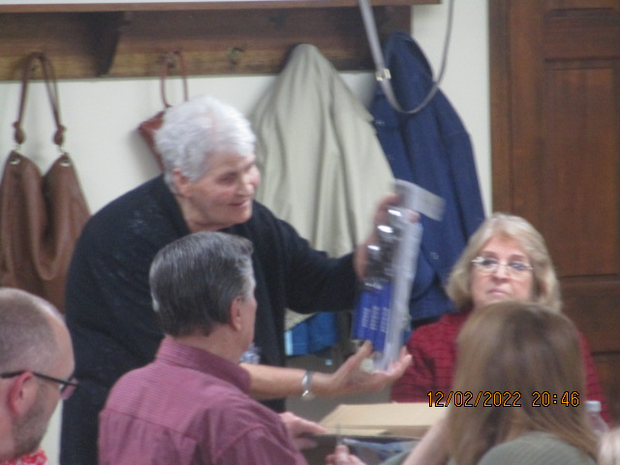
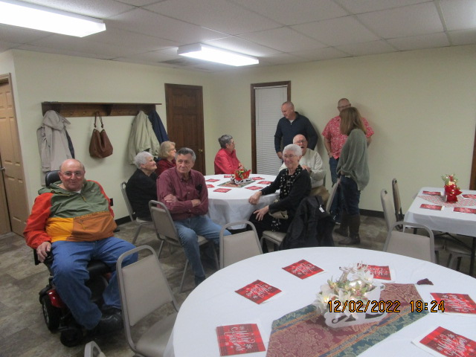
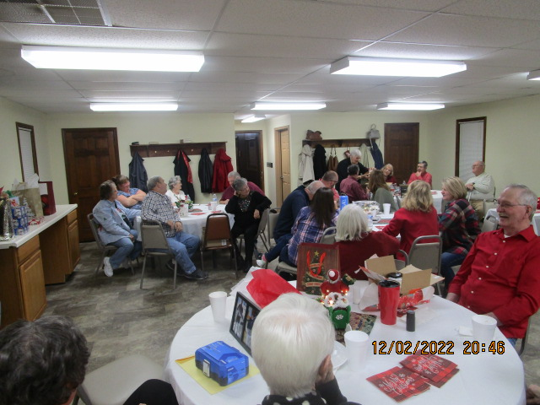
F is for Fellowship

Slide 6
A is for Attitude
World is full of grouches, cranks, and doubters.
Attitude determines Altitude
Say Great day, they respond Rain tomorrow.
Say Freshly sheared sheep, they said On this side.

Slide 7
A is for Attitude
(Philippians 2:3) Let nothing be done through selfish ambition or conceit, but in lowliness of mind let each esteem others better than himself.
(Philippians 2:4) Let each of you look out not only for his own interests, but also for the interests of others.
(Philippians 2:5) Let this mind be in you which was also in Christ Jesus,

Slide 8
M is for Message
Chuch family has a message, a purpose
Mission of the church is Salvation
Message is GOOD NEWS

Slide 9
I is for Involved
(Hebrews 10:24) And let us consider one another in order to stir up love and good works,
Provoke, stimulate, encourage, support each other
We are involved in each others lives

Slide 10
L is for Love
(John 13:34) A new commandment I give to you, that you love one another; as I have loved you, that you also love one another.
(John 13:35) By this all will know that you are My disciples, if you have love for one another."

Slide 11
Y is for Yearning
Do you have the desire?
Romans 10:1 My hearts desire
What is your goal for this family of God in the coming year?
What are your personal goals as a part of this family?

Slide 12
WE ARE F A M I L Y
F is for Fellowship
A is for Attitude
M is for Message
I is for Involved
L is for Love
Y is for Yearning

