Slide 1
CLOSED EYES
OPEN EYES

Slide 2
Matthew 13:13-15
Therefore I speak to them in parables, because seeing they do not see, and hearing they do not hear, nor do they understand. 14 And in them the prophecy of Isaiah is fulfilled, which says: 'HEARING YOU WILL HEAR AND SHALL NOT UNDERSTAND, AND SEEING YOU WILL SEE AND NOT PERCEIVE; 15 FOR THE HEARTS OF THIS PEOPLE HAVE GROWN DULL. THEIR EARS ARE HARD OF HEARING, AND THEIR EYES THEY HAVE CLOSED, LEST THEY SHOULD SEE WITH THEIR EYES AND HEAR WITH THEIR EARS, LEST THEY SHOULD UNDERSTAND WITH THEIR HEARTS AND TURN, SO THAT I SHOULD HEAL THEM.'

Slide 3
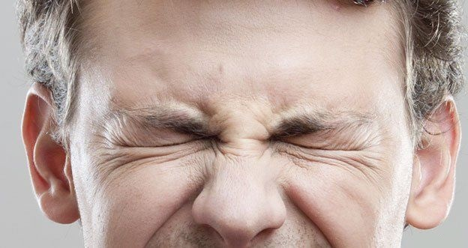
Closed Eyes
Paul quotes the same passage from Isaiah in Acts 28:25-27
There are many who have concrete minds – MIXED UP AND SET!
Some will turn their away from the truth.
Some reject anything other than what they have been taught.

Slide 4
Closed Eyes
Physical blindness is a medical condition – not chosen
These verses show a DELIBERATE closing of the eyes
What is the purpose of closing the eyes?
1. Do not want to understand
2. Do not want to hear the truth
3. Do not want to turn from their sin
4. Do not want to be healed (saved)

Slide 5
Open Eyes
(Acts 26:15) So I said, 'Who are You, Lord?' And He said, 'I am Jesus, whom you are persecuting.
(Acts 26:16) But rise and stand on your feet; for I have appeared to you for this purpose, to make you a minister and a witness both of the things which you have seen and of the things which I will yet reveal to you.

Slide 6
Open Eyes
(Acts 26:17) I will deliver you from the Jewish people, as well as from the Gentiles, to whom I now send you,
(Acts 26:18) to open their eyes, in order to turn them from darkness to light, and from the power of Satan to God, that they may receive forgiveness of sins and an inheritance among those who are sanctified by faith in Me.'

Slide 7
Open Eyes
Jesus made some promises to Paul
1. Jesus will reveal what you need to know
2. Deliver you from enemies (Jew / Gentile)
3. Jesus is sending Paul to them (enemies)
WHY WOULD JESUS DO THAT?

Slide 8
Open Eyes
JESUS SENT PAUL TO:
1. Open their eyes
2. Turn them from darkness to light
3. Turn them from the power of Satan
4. They can receive the forgiveness of sins
5. Obtain an inheritance (heaven)

Slide 9
Open Eyes
Jesus has been raised from the grave.
He meets 2 men on the road to Emmaus
They are sad and discouraged.
They thought Jesus was the coming Messiah.
Now he has died and their hope is gone.

Slide 10
Open Eyes
Jesus shows them that He fulfilled the Scriptures about the coming Messiah.
He is invited to their house for the night.
He sits with them to eat a meal and gives thanks for the food.

Slide 11
Open Eyes
Luke 24:31-32 Then their eyes were opened and they knew Him; and He vanished from their sight. 32 And they said to one another, "Did not our heart burn within us while He talked with us on the road, and while He opened the Scriptures to us?"

Slide 12
Open Eyes
Their eyes were opened
1. They knew Jesus.
2. Their hearts burned as He talked with them.
3. He opened the Scriptures to them.

Slide 13
Closed Eyes or Open Eyes?
Have you closed your eyes to the truth?
Are your eyes open to the Scriptures?

