Slide 1
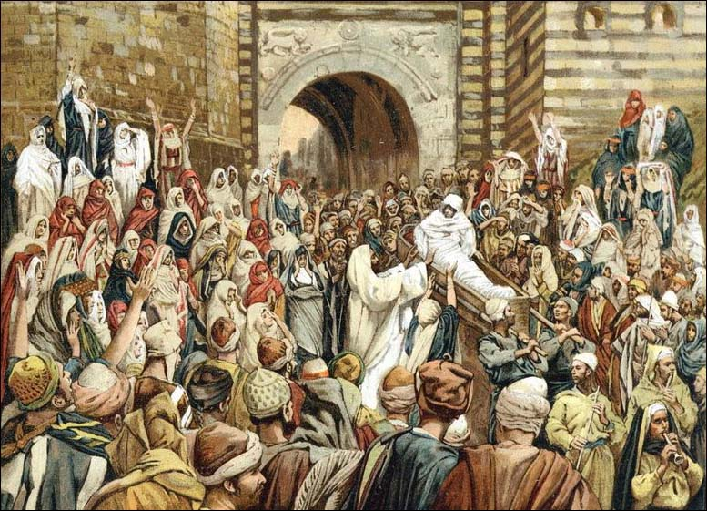
Jesus in the Midst

Slide 2
Jesus in the Midst
Shadrach, Meshach and Abed-Nego we punished for refusing to worship the gold image of the king.
(Daniel 3:25) "Look!" he answered, "I see four men loose, walking in the midst of the fire; and they are not hurt, and the form of the fourth is like the Son of God.“
Many believe the fourth was Jesus. He was in the fiery furnace with them. He was with them in the worst trial of their faith.

Slide 3
Jesus in the Midst
Jesus promises the same for each of us.
(Matthew 28:20) teaching them to observe all things that I have commanded you; and lo, I am with you always, even to the end of the age." Amen.
(Hebrews 13:5) Let your conduct be without covetousness; be content with such things as you have. For He Himself has said, "I WILL NEVER LEAVE YOU NOR FORSAKE YOU."

Slide 4
In the midst of doctors / lawyers
(Luke 2:46) Now so it was that after three days they found Him in the temple, sitting in the midst of the teachers, both listening to them and asking them questions.
Listening
Jesus was 12.
They were astonished at his understanding and answers about the law of God.

Slide 5
In the midst of disciples
(John 20:19) Then, the same day at evening, being the first day of the week, when the doors were shut where the disciples were assembled, for fear of the Jews, Jesus came and stood in the midst, and said to them, "Peace be with you."
(John 20:20) When He had said this, He showed them His hands and His side. Then the disciples were glad when they saw the Lord.
Comforting
Jesus assured them of his resurrection.

Slide 6
In the midst of assembly
(Matthew 18:20) For where two or three are gathered together in My name, I am there in the midst of them.“
Gathering
Jesus presence give confidence and assurance.
We are assured that Jesus is in our assembly.

Slide 7
In the midst of the churches
(Revelation 1:13) and in the midst of the seven lampstands One like the Son of Man, clothed with a garment down to the feet and girded about the chest with a golden band.
Judging
To be a Christ-centered church, we must live Christ-centered lives.

Slide 8
In the midst of worship
(Hebrews 2:12) saying: "I WILL DECLARE YOUR NAME TO MY BRETHREN; IN THE MIDST OF THE ASSEMBLY I WILL SING PRAISE TO YOU.“
Singing
In singing we teach one another.
We also speak to God – our faith, our devotion, our hope, our desire to be with Him.

Slide 9
In the midst of thieves
(John 19:18) where they crucified Him, and two others with Him, one on either side, and Jesus in the center.
Suffering
Jesus died FOR our sins.
One thief died TO his sins.
One thief died IN his sins.

Slide 10
In the midst of the Throne
(Revelation 5:6) And I looked, and behold, in the midst of the throne and of the four living creatures, and in the midst of the elders, stood a Lamb as though it had been slain, having seven horns and seven eyes, which are the seven Spirits of God sent out into all the earth.
Reigning
King of Kings; Lord of Lords; Head of His church

Slide 11
Jesus in the midst
Jesus in the midst effects every area of your life.
If Jesus is in your midst, He will make you accountable, hopeful, faithful, and responsible.
IS JESUS IN THE MIDST OF YOUR LIFE?

