Slide 1
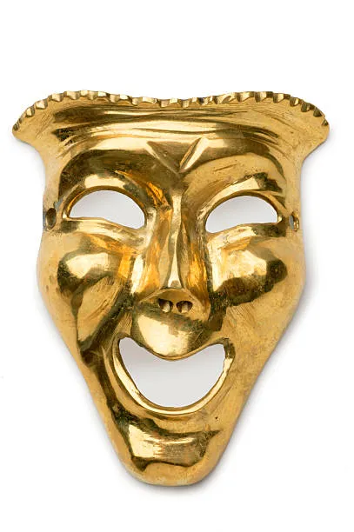
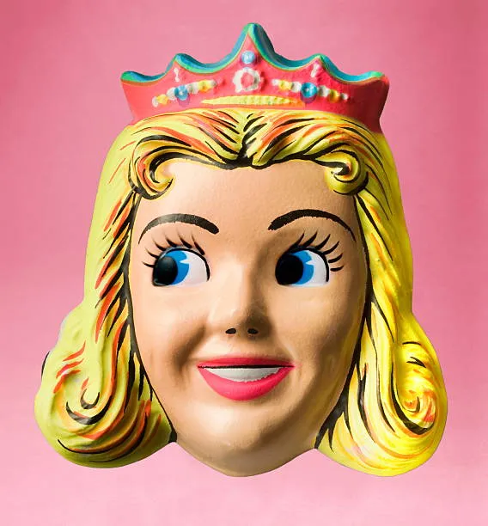
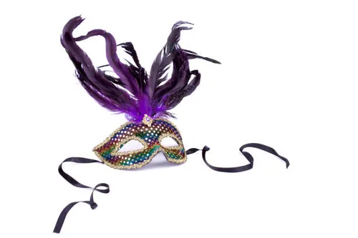
Masks of Sin
(Hebrews 3:12) Beware, brethren, lest there be in any of you an evil heart of unbelief in departing from the living God; (13) but exhort one another daily, while it is called "TODAY," lest any of you be hardened through the deceitfulness of sin.

Slide 2
Introduction
(Rom 7:11) For sin, taking occasion by the commandment, deceived me, and by it killed me.
SIN IS DECEITFUL.
Notice some ways sin wears a mask.

Slide 3
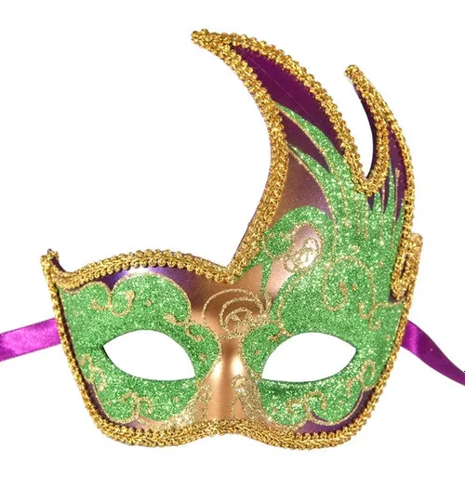
Sin wears a mask - - - 1. Do not judge.
(1Jn 4:7) Beloved, let us love one another, for love is of God; and everyone who loves is born of God and knows God.
(1Jn 4:8) He who does not love does not know God, for God is love.
Many think – “God is love so no one will be lost.”
There will be a judgment day.

Slide 4
Sin wears a mask - - - 1. Do not judge.
(2Co 5:10) For we must all appear before the judgment seat of Christ, that each one may receive the things done in the body, according to what he has done, whether good or bad.
(Joh 12:48) He who rejects Me, and does not receive My words, has that which judges him—the word that I have spoken will judge him in the last day.

Slide 5
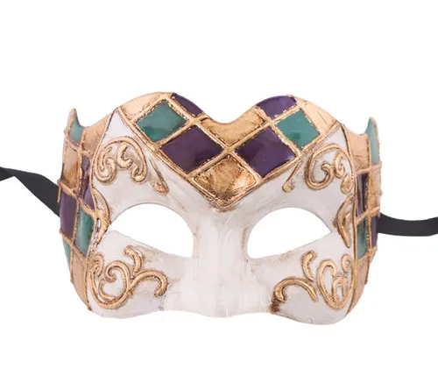
Sin wears a mask - - - 2. Of Pleasure.
(Heb 11:24) By faith Moses, when he became of age, refused to be called the son of Pharaoh's daughter,
(Heb 11:25) choosing rather to suffer affliction with the people of God than to enjoy the passing pleasures of sin,
(Heb 11:26) esteeming the reproach of Christ greater riches than the treasures in Egypt; for he looked to the reward.

Slide 6
Sin wears a mask - - - 2. Of Pleasure.
We reap what we sow.
(Gal 6:7) Do not be deceived, God is not mocked; for whatever a man sows, that he will also reap.
(Gal 6:8) For he who sows to his flesh will of the flesh reap corruption, but he who sows to the Spirit will of the Spirit reap everlasting life.
There will be a “payday someday.”

Slide 7
Sin wears a mask - - - 3. Pretending to be good.
TV and movies teach that sin is good.
(Isa 5:20) Woe to those who call evil good, and good evil; Who put darkness for light, and light for darkness; Who put bitter for sweet, and sweet for bitter!
(Isa 5:21) Woe to those who are wise in their own eyes, And prudent in their own sight!
(Pro 16:25) There is a way that seems right to a man, But its end is the way of death.

Slide 8
Sin wears a mask - - - 4. Making promises it can’t keep.
(2Pe 2:19) While they promise them liberty, they themselves are slaves of corruption; for by whom a person is overcome, by him also he is brought into bondage.

Slide 9
Sin wears a mask - - - 4. Making promises it can’t keep.
God keeps His promises.
(2Pe 3:8) But, beloved, do not forget this one thing, that with the Lord one day is as a thousand years, and a thousand years as one day.
(2Pe 3:9) The Lord is not slack concerning His promise, as some count slackness, but is longsuffering toward us, not willing that any should perish but that all should come to repentance.
(Pro 16:25) There is a way that seems right to a man, But its end is the way of death.

Slide 10
Sin wears a mask - - - 5. Of Popularity.
Everybody is doing it!!!
(Matthew 7:13) "Enter by the narrow gate; for wide is the gate and broad is the way that leads to destruction, and there are many who go in by it. (14) Because narrow is the gate and difficult is the way which leads to life, and there are few who find it. (15) "Beware of false prophets, who come to you in sheep's clothing, but inwardly they are ravenous wolves.

Slide 11
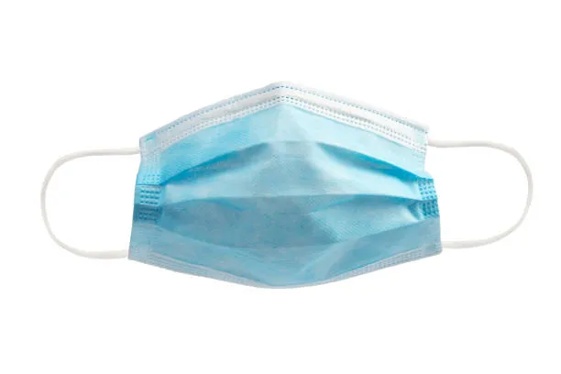
Sin wears a mask - - - 6. Of being your servant.
I can quit anytime I want to.
(Rom 6:16) Do you not know that to whom you present yourselves slaves to obey, you are that one's slaves whom you obey, whether of sin leading to death, or of obedience leading to righteousness?
(Rom 6:17) But God be thanked that though you were slaves of sin, yet you obeyed from the heart that form of doctrine to which you were delivered.
(Rom 6:18) And having been set free from sin, you became slaves of righteousness.

Slide 12
Sin wears a mask - - - 6. Of being your servant.
I can quit anytime I want to.
(Rom 6:20) For when you were slaves of sin, you were free in regard to righteousness.
(Rom 6:21) What fruit did you have then in the things of which you are now ashamed? For the end of those things is death.
(Rom 6:22) But now having been set free from sin, and having become slaves of God, you have your fruit to holiness, and the end, everlasting life.
(Rom 6:23) For the wages of sin is death, but the gift of God is eternal life in Christ Jesus our Lord.

Slide 13
Sin wears a mask - - - 7. Of living forever.
I am too young to die.
(Mar 13:32) "But of that day and hour no one knows, not even the angels in heaven, nor the Son, but only the Father.
(Mar 13:33) Take heed, watch and pray; for you do not know when the time is.
(Mar 13:34) It is like a man going to a far country, who left his house and gave authority to his servants, and to each his work, and commanded the doorkeeper to watch.

Slide 14
Sin wears a mask - - - 7. Of living forever.
I am too young to die.
(Mar 13:35) Watch therefore, for you do not know when the master of the house is coming—in the evening, at midnight, at the crowing of the rooster, or in the morning—
(Mar 13:36) lest, coming suddenly, he find you sleeping.
(Mar 13:37) And what I say to you, I say to all: Watch!"

